Slide 1
Subtitle: Built with React and ExpressJS Framework
Project Title: Music Player Website - Spotify Clone
Presented By:
Student Name:- Achhuta Nand Jha
College:- GLA University
Name-Department:- Computer Engineering & Applications

Slide 2
Introduction
Project Goal:
To create a fully functional music player website inspired by Spotify.
Provide an interactive user interface with seamless music playback.
Key Features:
Song listing and search functionality.
Responsive design.
Backend integration for music data.

Slide 3
Technology Stack
Frontend:
React.js
HTML5 & CSS3
JavaScript
Backend:
Node.js with Express.js

Slide 4
Features
UI Features:
Interactive playlist display.
Customizable song list.
Player controls (play, pause, next, previous).
Functionality:
Song streaming.
Track progress bar.
Responsive and mobile-friendly design.

Slide 5
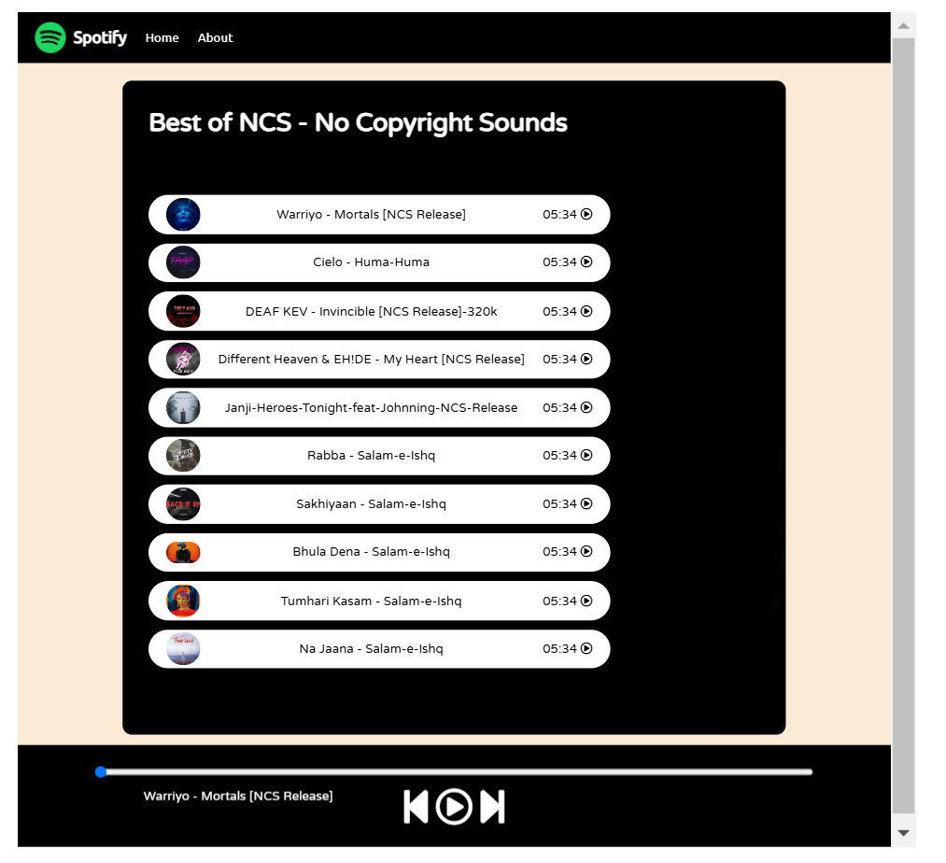
System Architecture
React (Frontend)
ExpressJS (Backend)

Slide 6
Key Challenges
Synchronizing music playback between components.
Implementing smooth transitions and animations.
Managing data between frontend and backend effectively.

Slide 7
Solutions
Used React Context API for state management.
Optimized ExpressJS routes for faster API responses.
Focused on modular component design.

Slide 8
RESULT
Show project
Github link

Slide 9
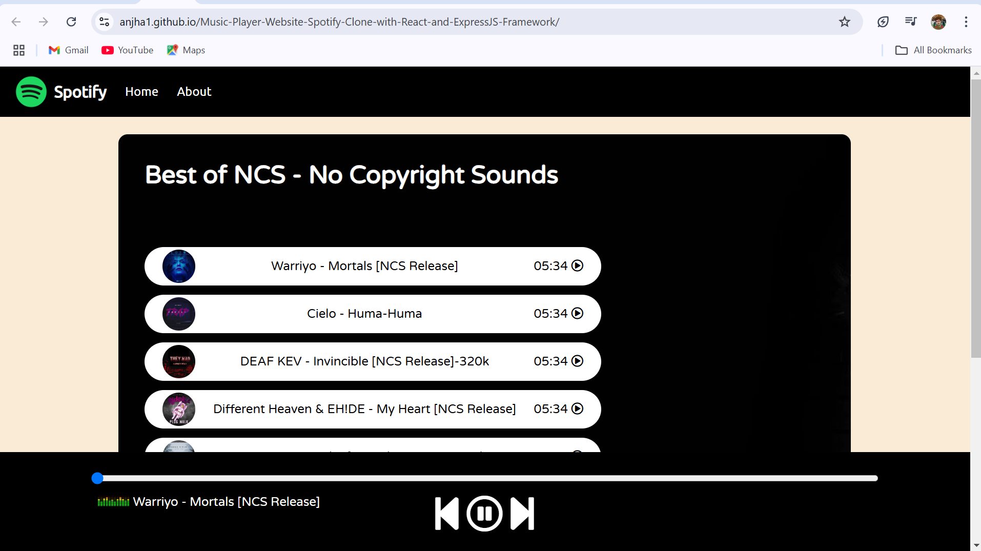
RESULT

Slide 10
Conclusion
Successfully built a Spotify-like music player using React and ExpressJS.
Gained hands-on experience with React components, hooks, and state management.
Implemented backend API integration for dynamic data handling.
Developed a responsive and user-friendly UI for seamless music playback.
Enhanced skills in full-stack web development.

Slide 11
THANK YOU

